Slide 1
Intro to cache memory
Kosarev Nikolay
MIPT
Nov, 2009

Slide 2
Agenda
Cache
Placement of cache block
Searching of data in the cache
Replacement policies
Write policies

Slide 3
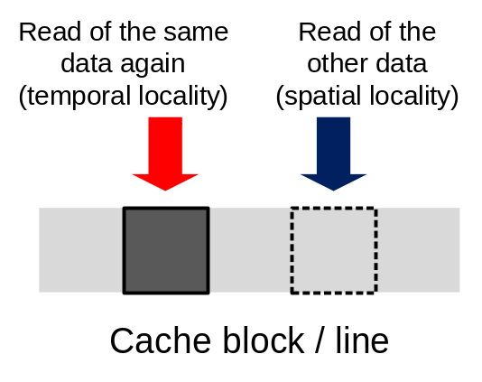
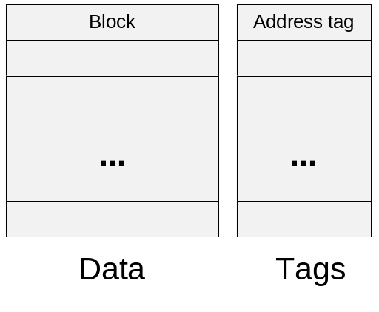
Cache
Cache is a buffer for storing of data copies for rapid access
Takes advantage of the principle of locality (temporal, spatial)
Consists of blocks / lines (portions of data retrieved from the main memory)
Each block has an address tag (address of the block in the main memory)
Hit (Miss) – data was found (wasn’t found) in the cache

Slide 4
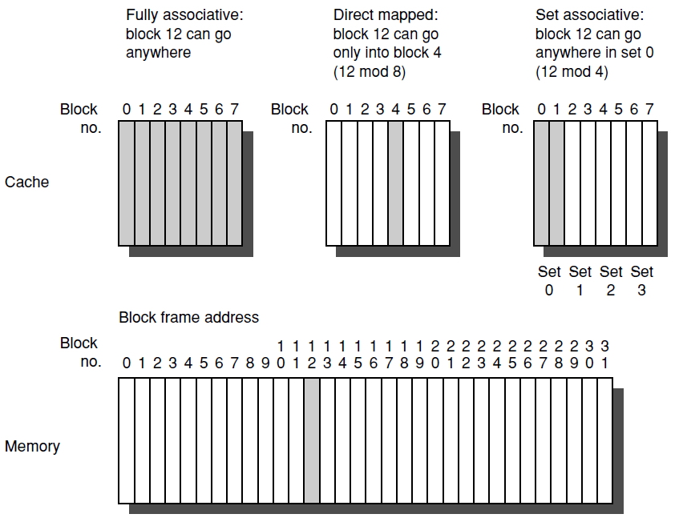
Placement of cache block
3 types of cache
Direct mapped: (block address) mod (blocks in cache)
Set associative: (block address) mod (sets in cache)
Fully associative
2-way set associative cache

Slide 5
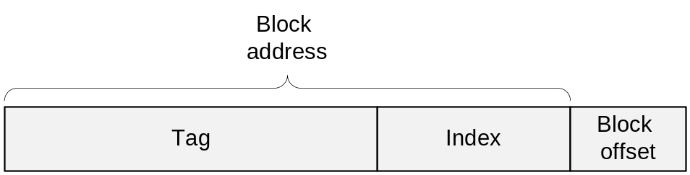
Searching of data
Processor address is analyzed
Index field selects the set
Tag is compared against all blocks in set for a hit
Offset field selects data from the block
Note: all address tags are searched in parallel
  Cache HIT access time is critical

Slide 6
Replacement policies
3 frequently used algorithms
Random
  Simple to implement
Least recently used (LRU)
  Block unused for the longest time is replaced
  Complicated to calculate -> approximated
First in first out (FIFO)
  The oldest block is replaced

Slide 7


